Slide 1

ທ ເຊັງວ່າງ ບຼົ່ງໄມ ຫ້ອງ 3wc1
Seo &
googl analytics

Slide 2
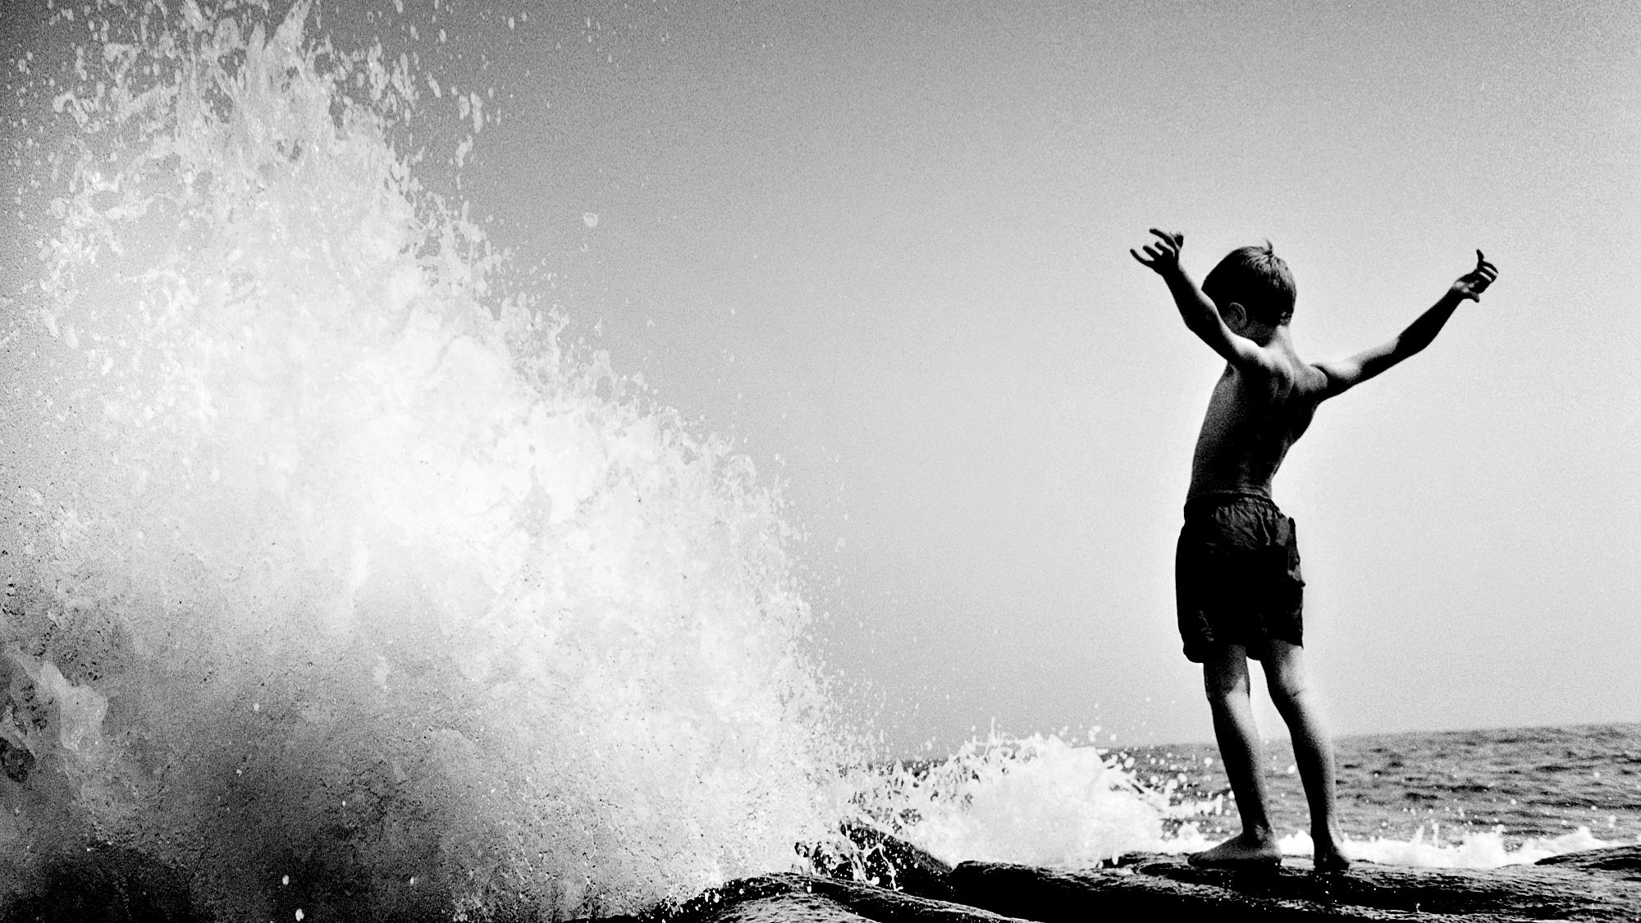
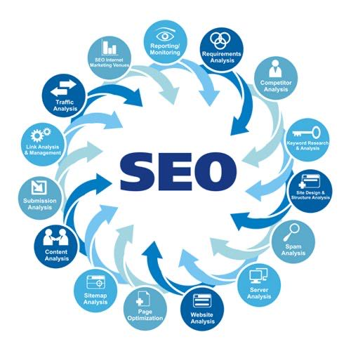




1. seo
Search Engine Optimization.
(Search Engine) ແມ່ນຫຍັງ?
ການທຳ seo ມີຈັກແບບ?
1 seo google
2 google map seo
3 Image seo
4 youtube seo
5 facebook , twintter

Slide 3

2. Google analytics
Google analytics ແມ່ນຫຍັງ ?
Google analytics ເກັບຂໍ້ມູນໃດແດ່?
ວິສະໜັກ Google analytics ?

Slide 4
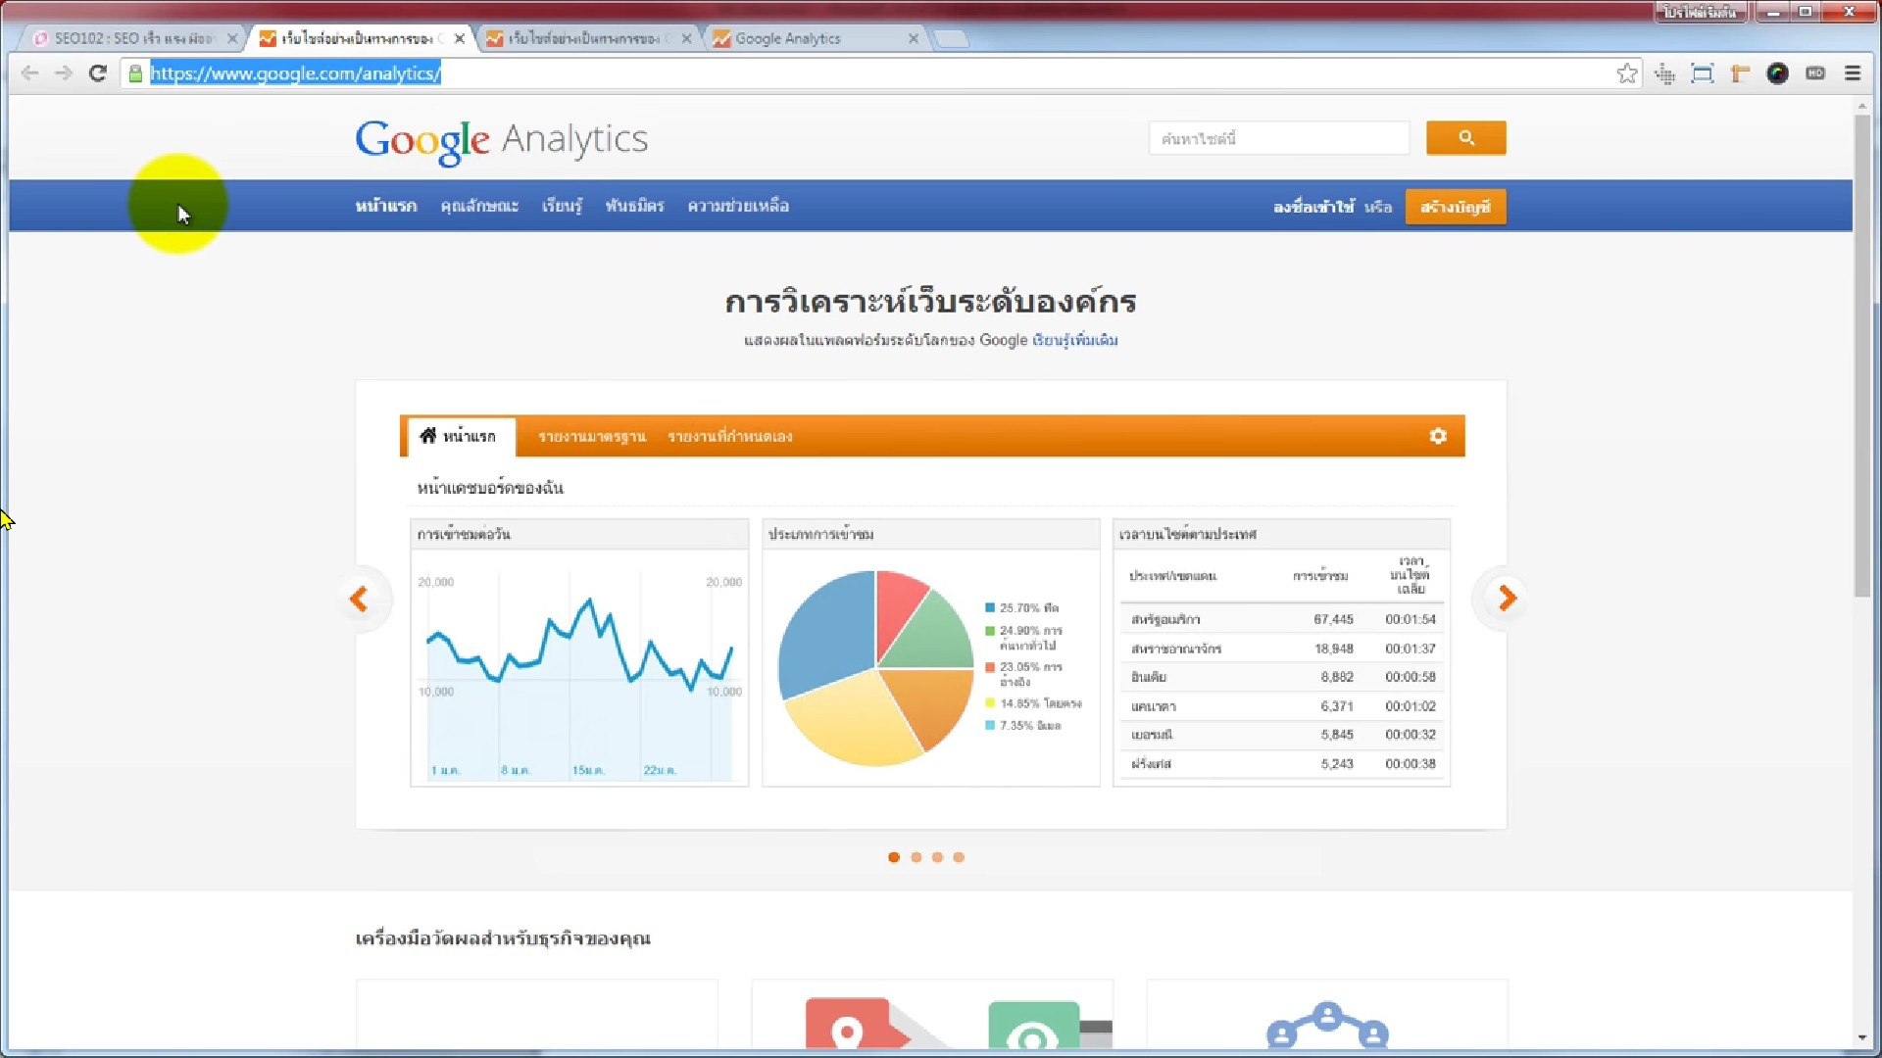

Slide 5
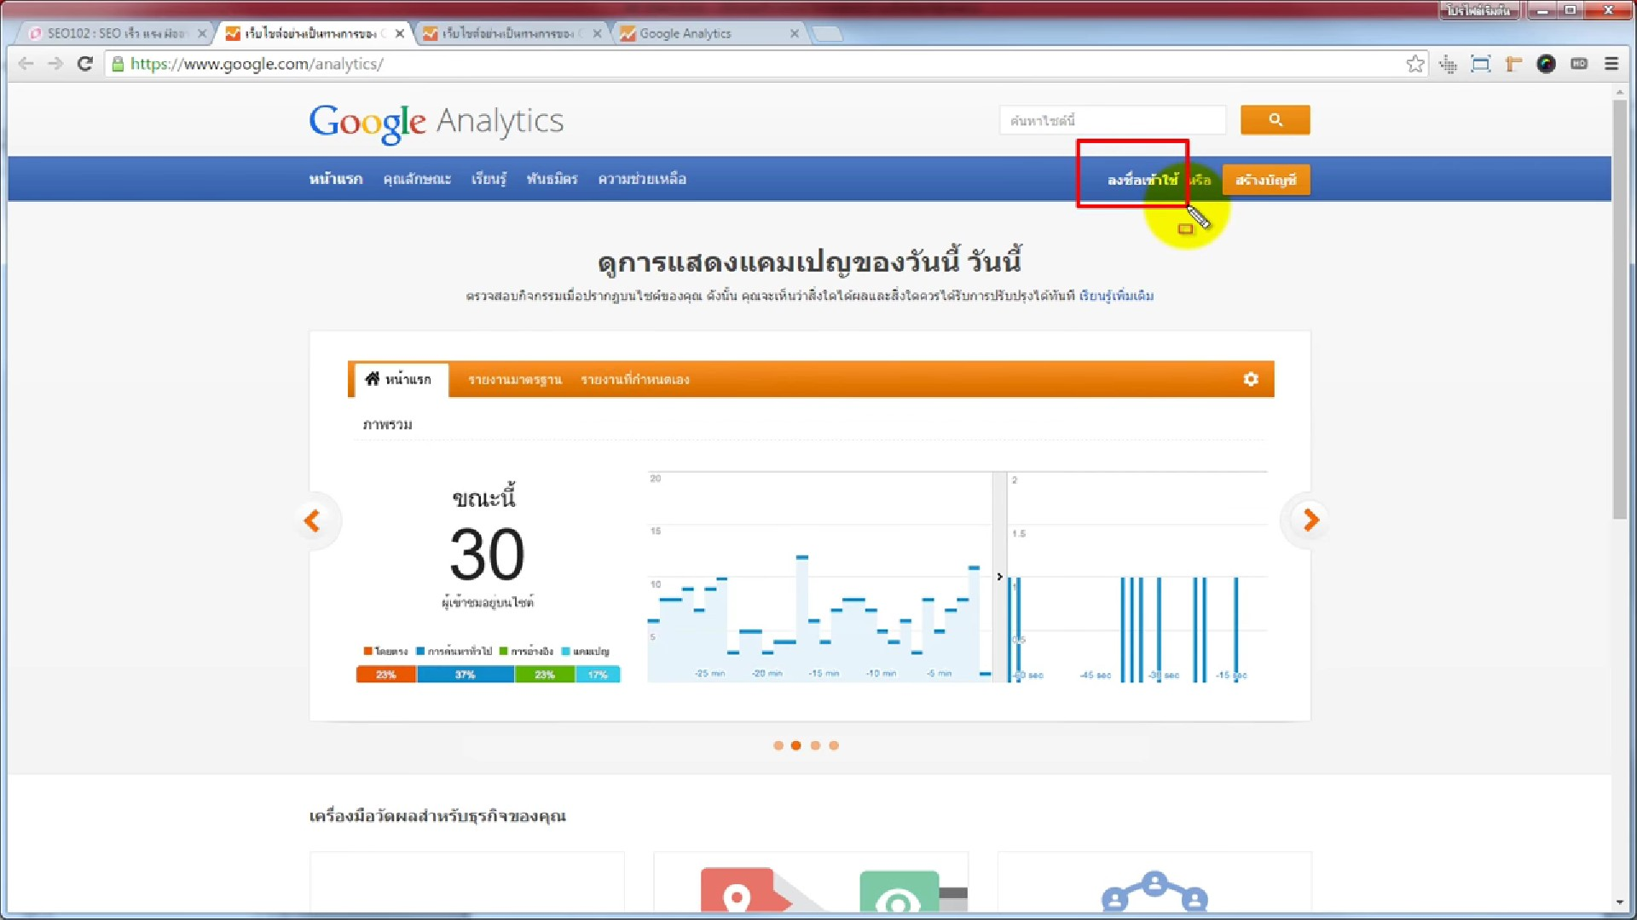

Slide 6
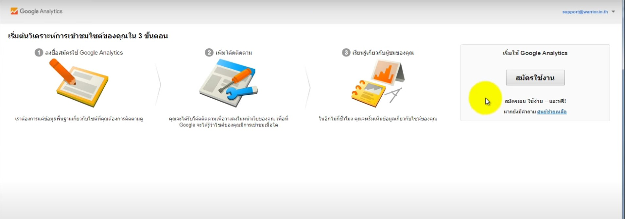

Slide 7
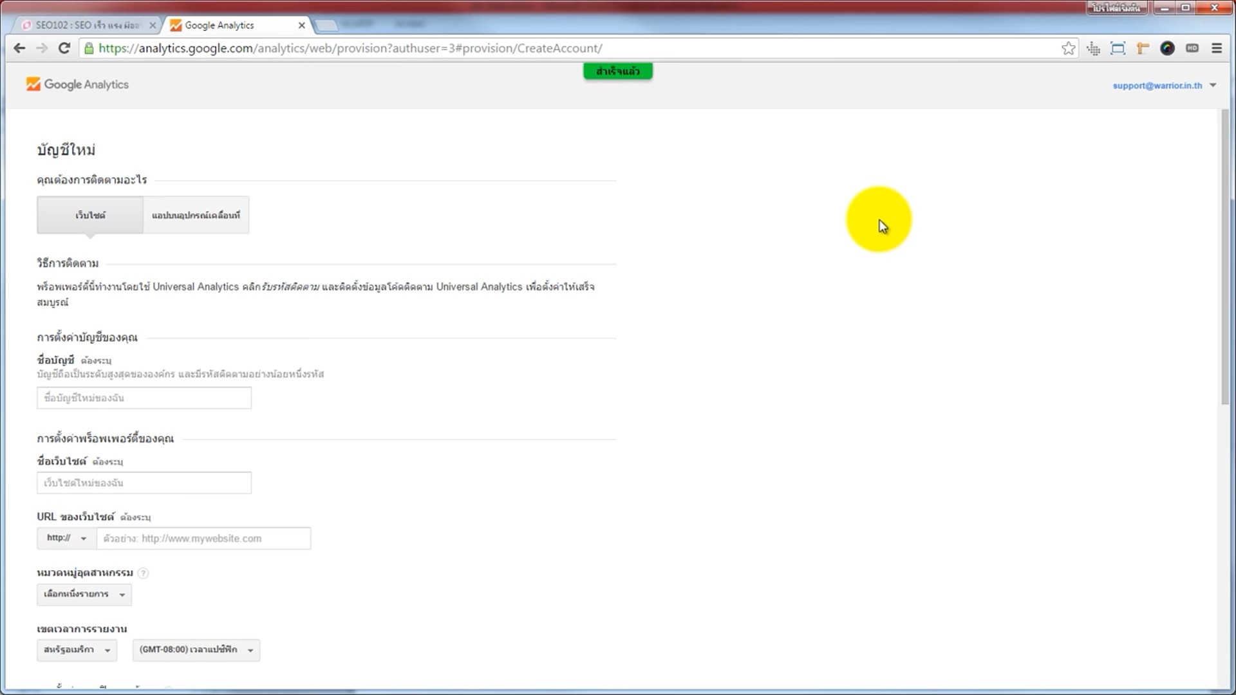

Slide 8
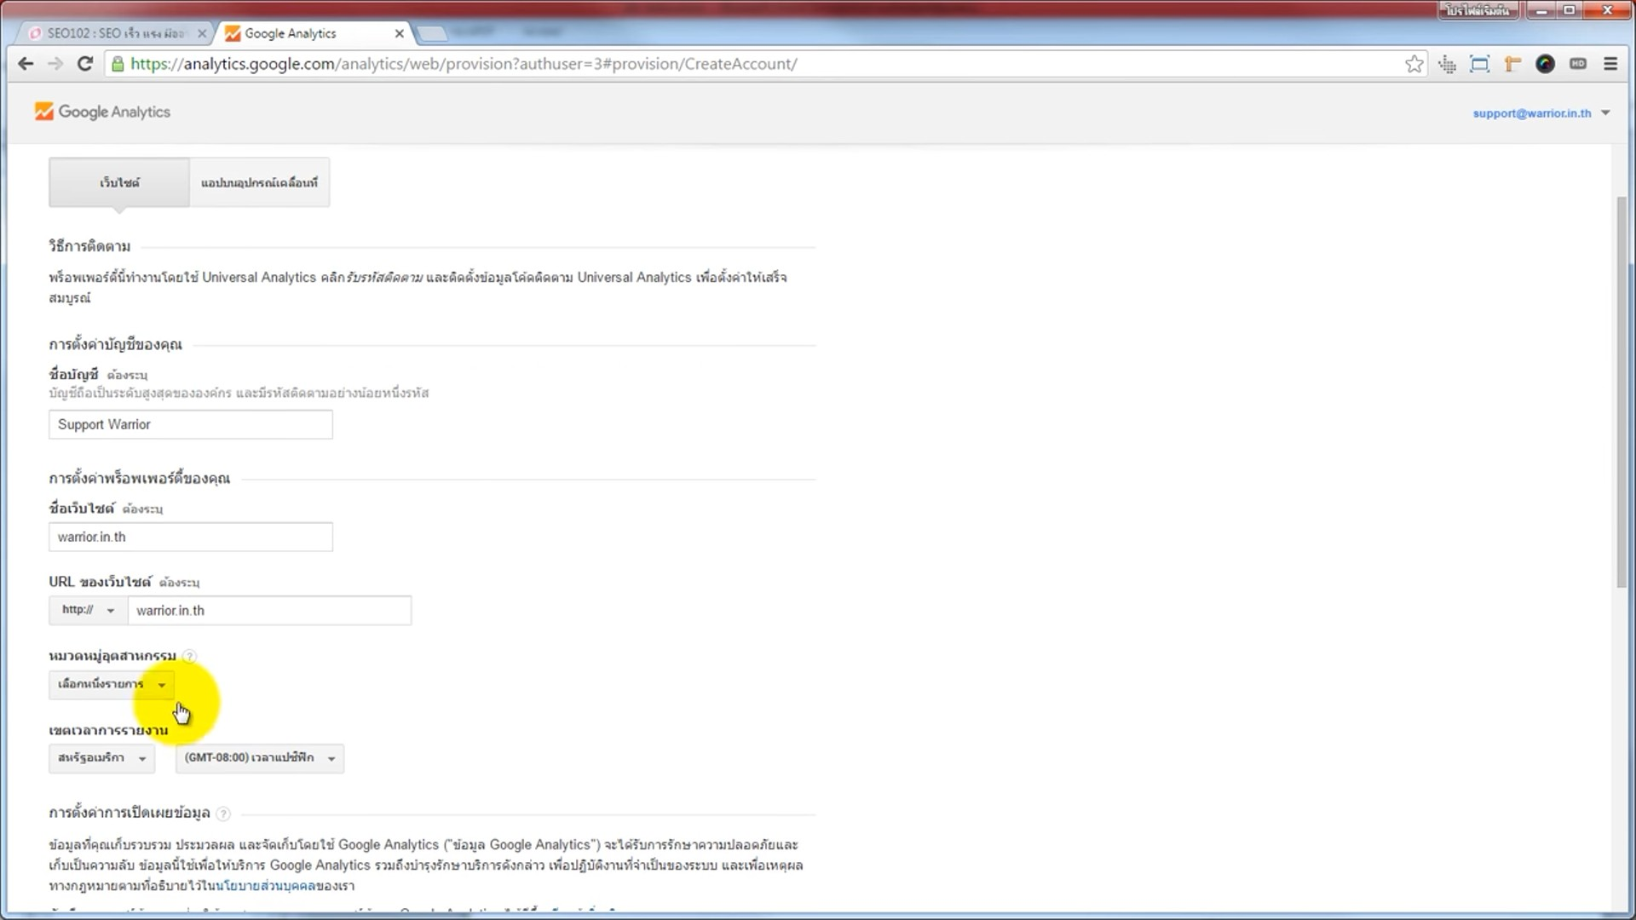

Slide 9
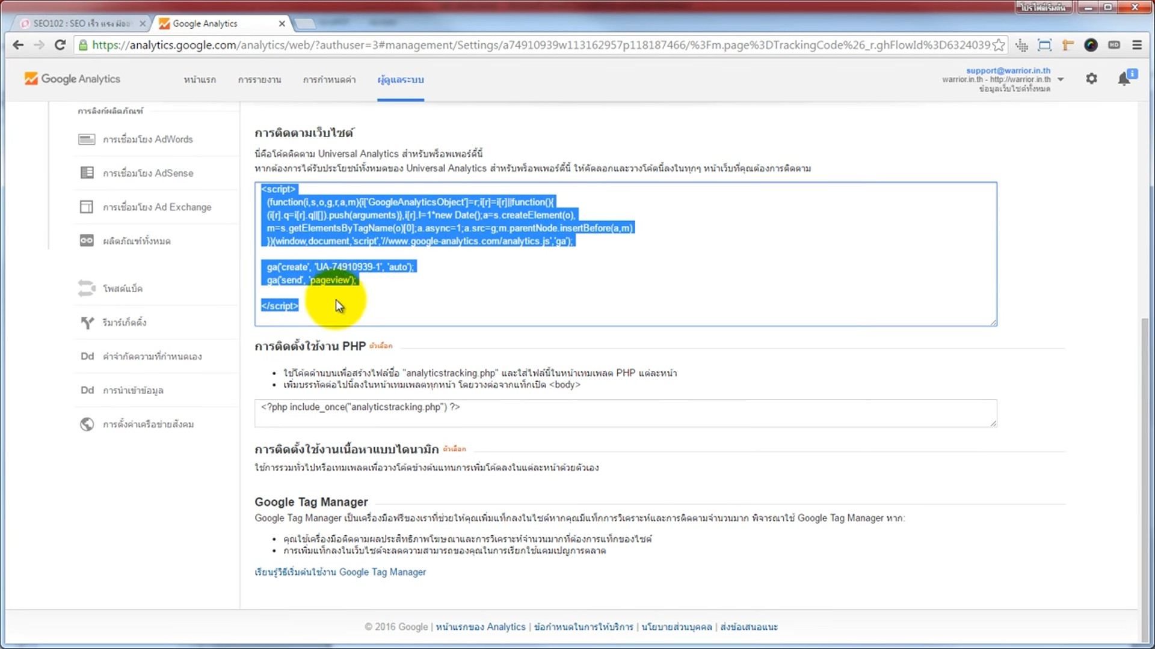

Slide 10
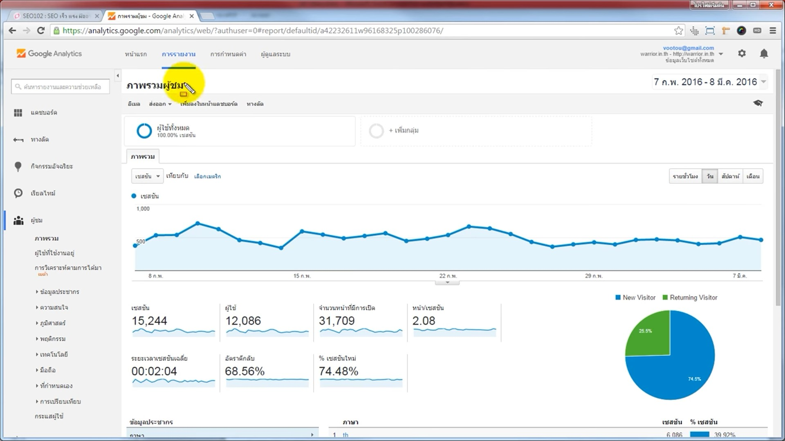

Slide 11
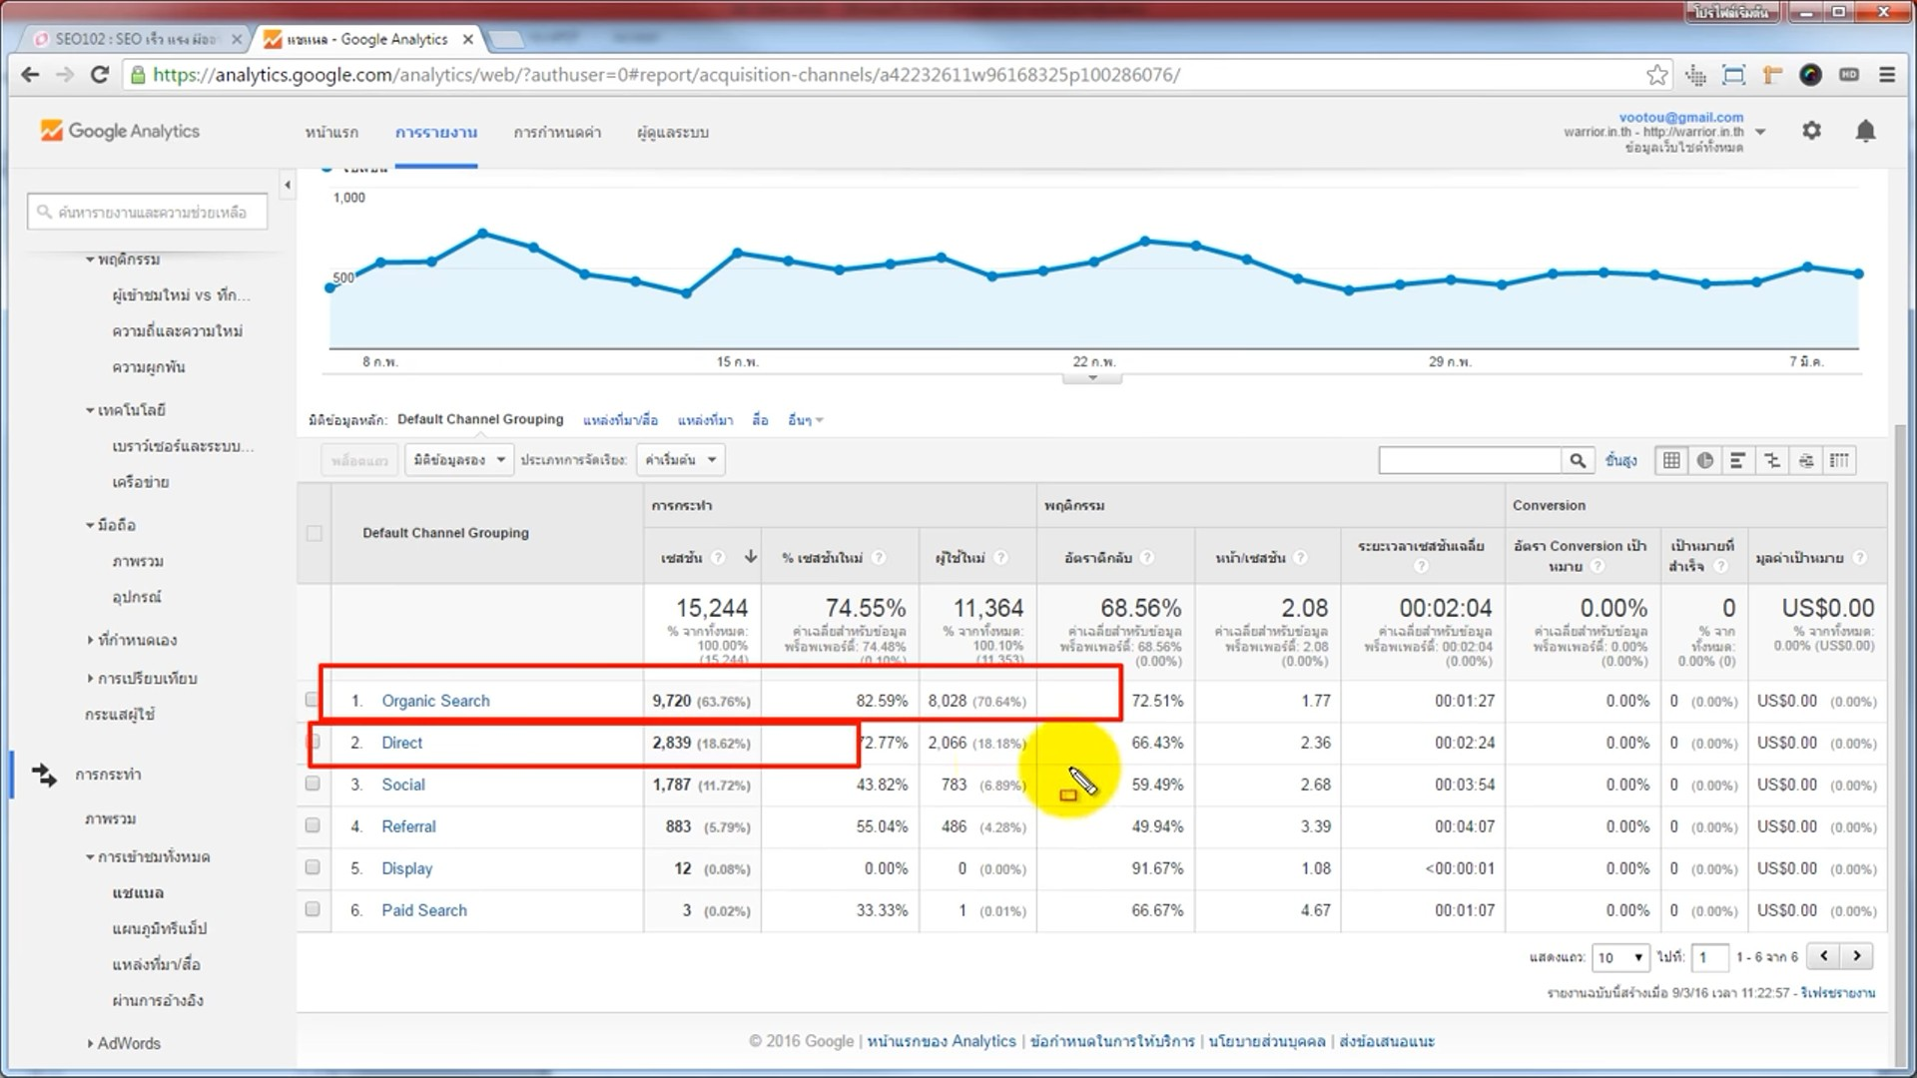

Slide 12
ຂໍ້ມູນອ້າງອິງຈາກ:
https://www.2bearsmarketing.com/seo-%E0%B8%84%E0%B8%B7%E0%B8%AD%E0%B8%AD%E0%B8%B0%E0%B9%84%E0%B8%A3-%E0%B8%AA%E0%B8%B3%E0%B8%84%E0%B8%B1%E0%B8%8D%E0%B8%AD%E0%B8%A2%E0%B9%88%E0%B8%B2%E0%B8%87%E0%B9%84%E0%B8%A3/

